Slide 1
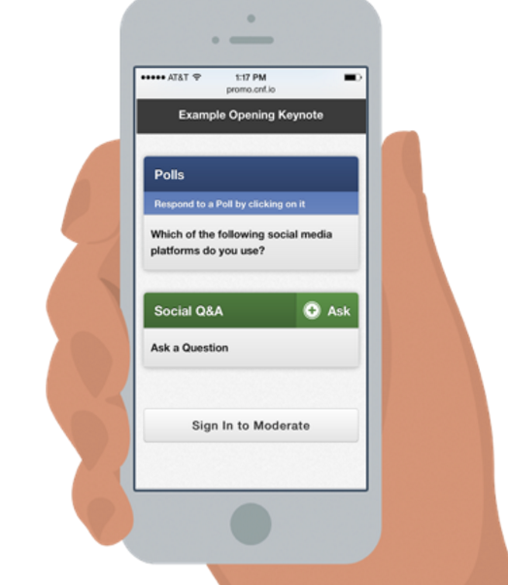
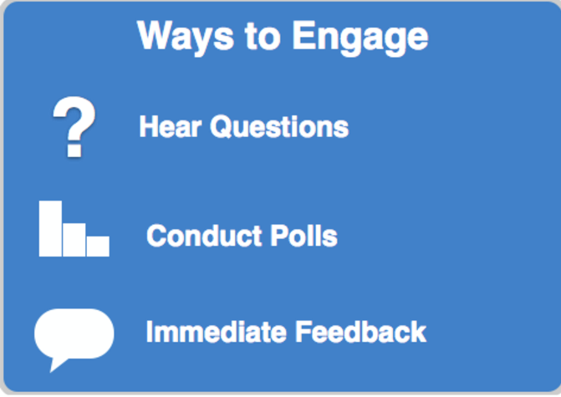
The Conferences i/o Audience Response System (ARS) is an easy way to Interact & Engage with your attendees in real-time

Slide 2
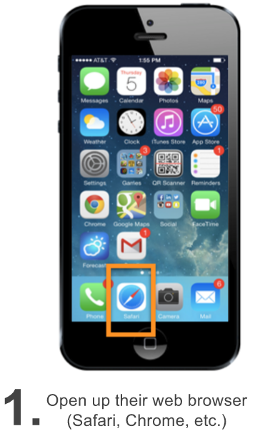
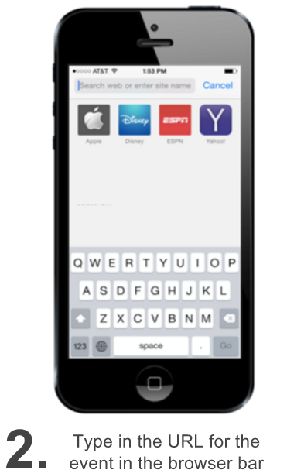
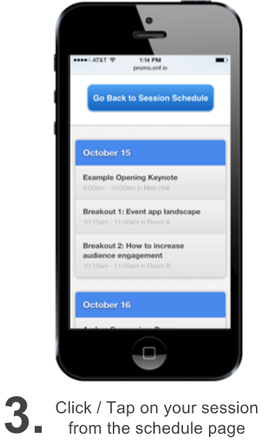
How Attendees Participate
Attendees simply navigate to a URL using any device with an internet browser (Smartphone, Tablet, Laptop, etc.)

Slide 3
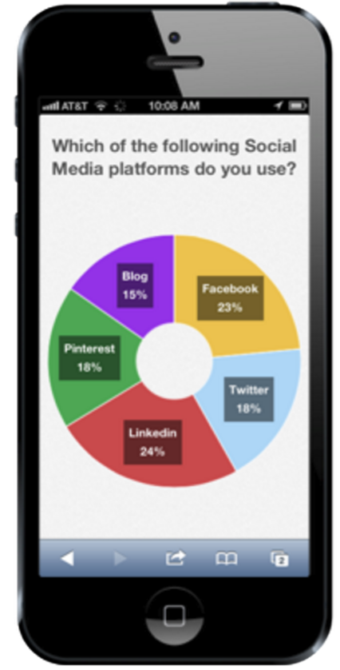
How Polling Works
You will create the poll question prior to the event
You will be able to control when your attendees can respond to each question during the session
When a poll becomes available, it will appear on the attendees’ device and they will respond
You will view the results graphically, in real- time. Results will appear on the big screen.

Slide 4
How do you add polls to your presentation? (Overview of steps)
1) Install the PowerPoint Add-in
2) Sign-in as the Moderator
3) Create Polls
4) Add polls to the PowerPoint Presentation

Slide 5
Download the PowerPoint Add-In

Slide 6
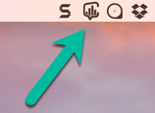
Download the PowerPoint Add-In
Windows Users: Download the Zip File by clicking here:
Note: Some browsers scan files that are downloaded for malware, and they may take offense to this ZIP file as it contains an executable program. If you see a warning, you may need to override the warning, or temporarily disable security settings.
Mac Users: Download the Zip File by clicking here:
Note: the next two pages are for Windows users. For Mac users, just make sure that the Conferences i/o Mac App is running in order to test or conduct live polling in PowerPoint.

Slide 7
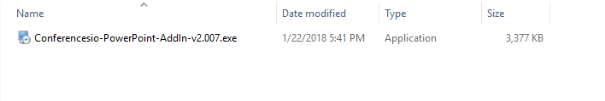
Windows Users (cont’d)
2. Unzip (extract) the downloaded ZIP file. (If you need help with this, see the 90 second video tutorial that is featured on the download page).
3. Click on Conferencesio PowerPoint Add-In Installer.
4. Follow the prompts from the Setup Wizard

Slide 8
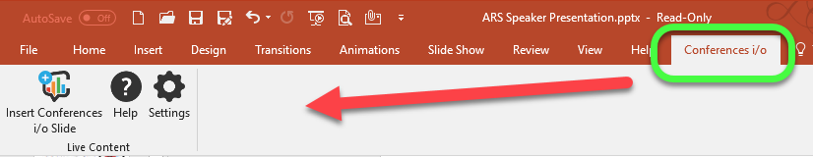
Windows Users (cont’d)
5. Open PowerPoint. Note: if PowerPoint was opened during the installation of the add-in, close PowerPoint and re-open it.
6. You should see a new menu (after ‘Help’) called Conferences i/o. It will feature a button that says “Insert Conferences i/o Slide”.

Slide 9
Sign-in as the Moderator
Notes:
Now you’re going to want to sign in as the moderator…..let’s go over how you would do so!

Slide 10
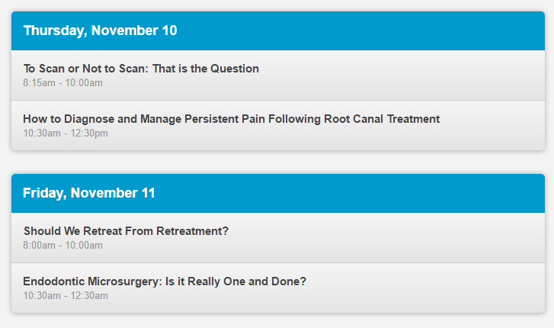
Sign in as the Moderator
Navigate to the URL for your event and click on your session from the schedule page.
Event URL : xxxxxx.cnf.io
2. Click on your session.

Slide 11
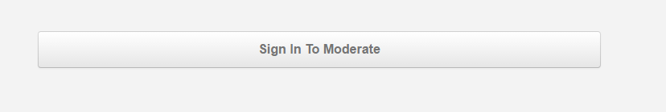
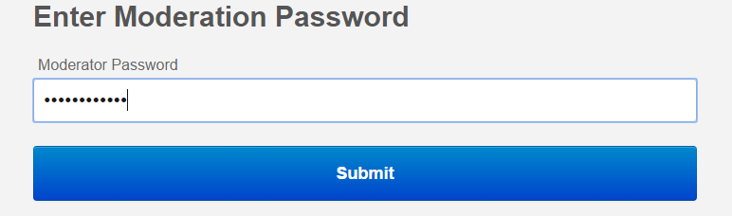
Sign in as a Moderator (cont’d.)
3. Click on Sign in To Moderate.
Type in Moderator Password: xxxxx
Notes:
Type in the password and hit submit.

Slide 12
Create Polls
Notes:
Now you can create your polls!

Slide 13
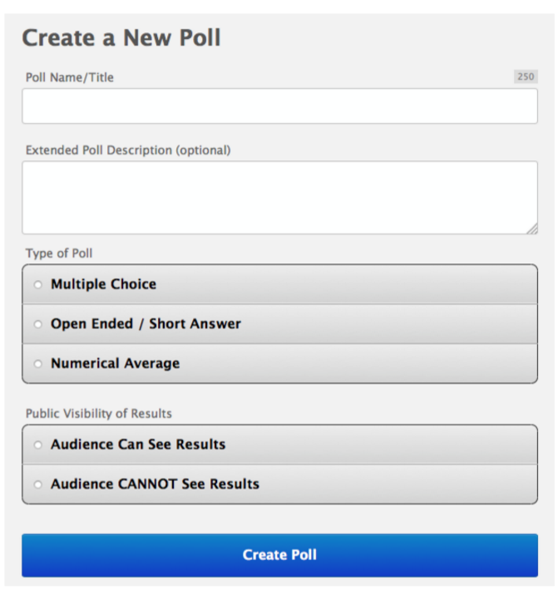
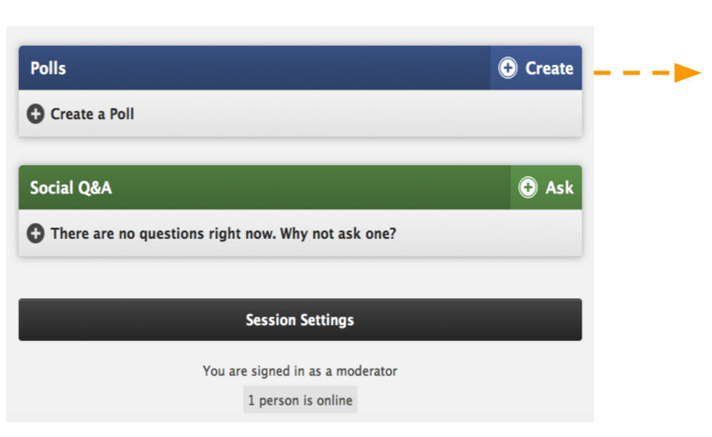
Create Polls
1. Under the Polls section, click Create.

Slide 14
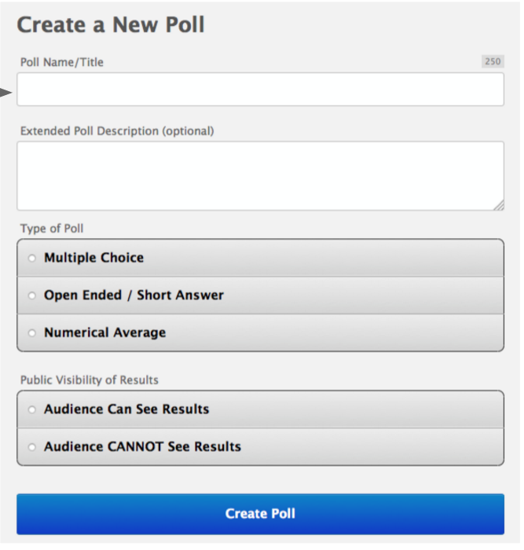
Create Polls (cont’d)
2. Fill in the Following Information
Type in the question that you’re asking
Choose the type of poll you want to conduct
Decide if you want your attendees to be able to view the results of the poll on their own device, or not

Slide 15
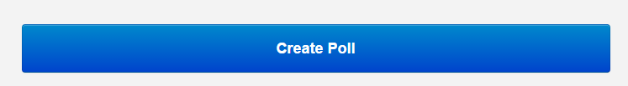
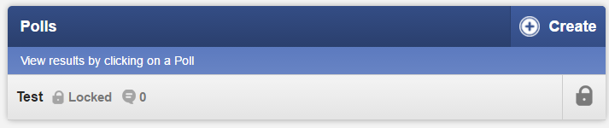
Create Polls (cont’d)
4. Click Create Poll to save.
The polls will appear like so (note: it’s normal that they are ‘Locked’)

Slide 16
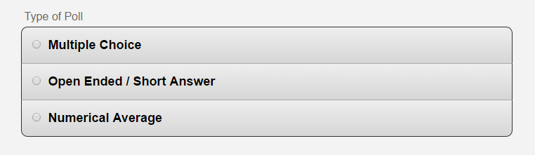
Poll Types
Note: The most common poll type will be multiple choice.

Slide 17
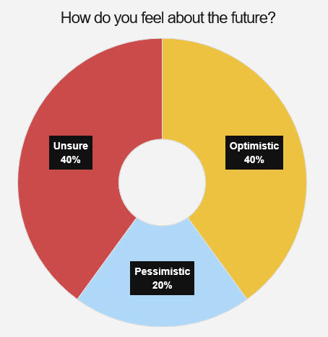
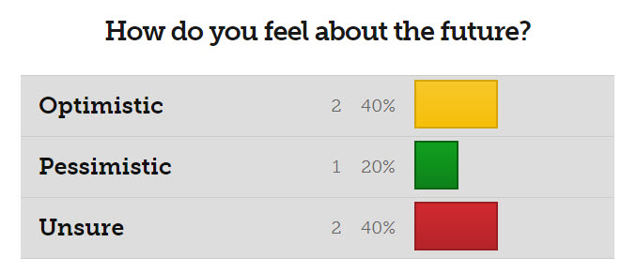
Multiple Choice
Results can be displayed in a Pie Chart or Bar Chart

Slide 18
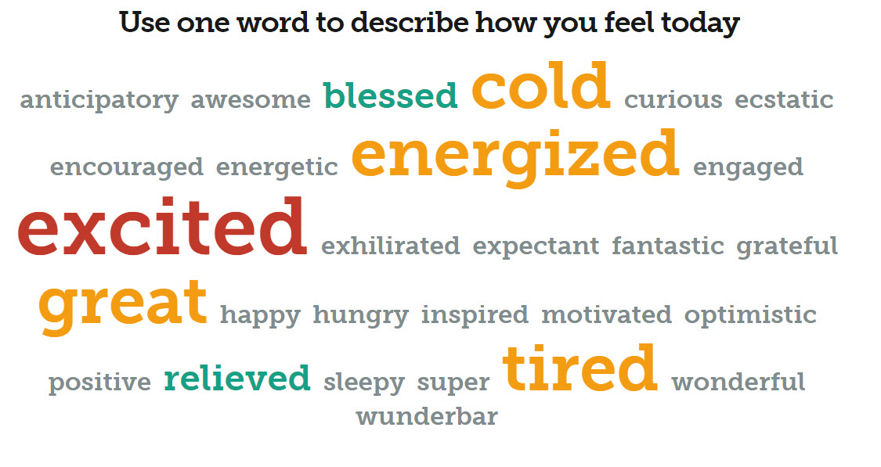
Open Ended Poll Type
Results can be displayed in a simple running list or in a “Word Cloud”

Slide 19
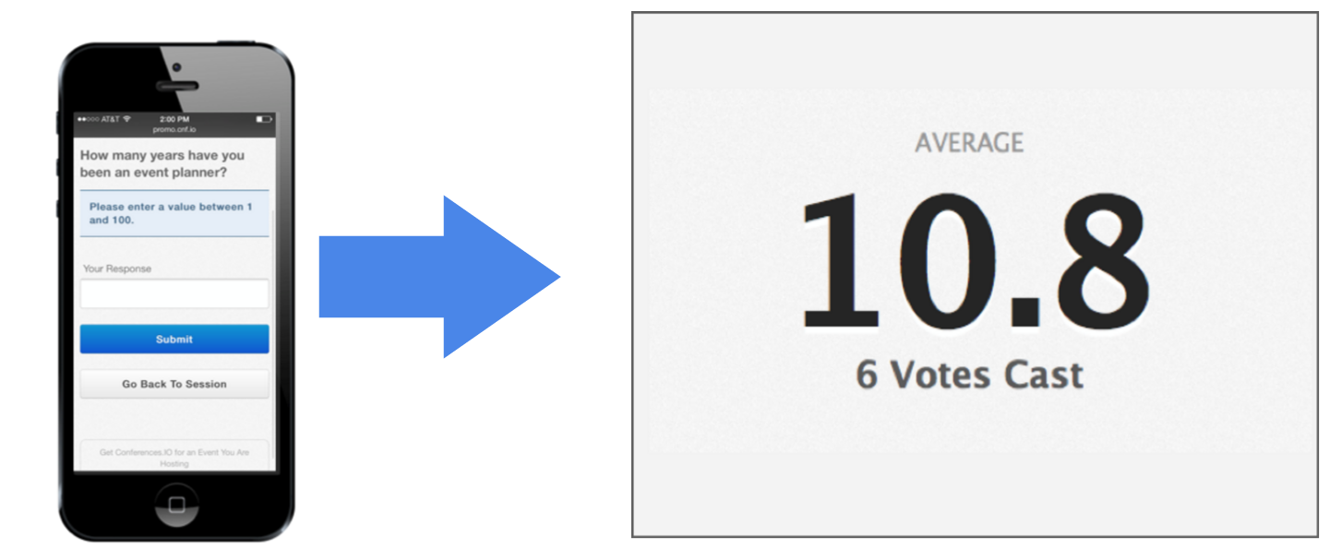
Numerical Average
Results will display the overall average of all the responses

Slide 20
Adding polls to a PowerPoint Presentation
There are two methods to add poll slides into your slidedeck.
Method #1 – Use the “Download All Live Content Slides” button which creates a PowerPoint file for you. The file will contain your special Poll slides. Copy/paste these slides into your presentation. This is the recommended method. See this video for a quick tutorial or click to next slide for written instructions.
Method #2 – Use the “Insert a Slide” button to add each poll, one at a time, into your Presentation. For written instructions, skip to slide 25.

Slide 21
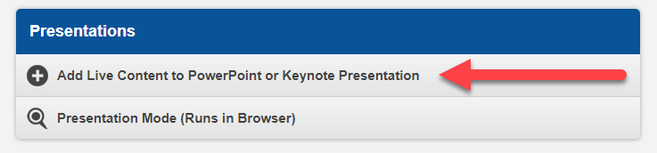
Adding polls to the PowerPoint Presentation (Method #1)
Click on Session Settings.
Select Add Live Content to PowerPoint.

Slide 22
Add polls to the PowerPoint
(Method #1 cont’d)
In the list of supported platforms, choose either Windows PowerPoint Add-In, or the Mac App (based on the type of computer you use).
Click the dark button entitled “Download All Live Content Slides”
Open the PowerPoint file that is generated for you.

Slide 23
Add polls to the PowerPoint
(Method #1 cont’d)
In the list of supported platforms, choose either Windows PowerPoint Add-In, or the Mac App (based on the type of computer you use).
Click the dark button entitled “Download All Live Content Slides”
Open the PowerPoint file that is generated for you.

Slide 24
Add polls to the PowerPoint
(Method #1 cont’d)
Follow the directions on the first slide, which indicates that you can either copy & paste or drag & drop the ‘Live Content’ slides in this PowerPoint file into your destination presentation.
Skip to slide #29 in this deck to continue with how to test your polls.

Slide 25
Adding polls to the PowerPoint Presentation (Method #2)
Click on Session Settings.
Select Add Live Content to PowerPoint.

Slide 26

Add polls to the PowerPoint Presentation (Method #2 cont’d)
3. Scroll down the page till you see your poll questions listed.
Highlight and copy the SLIDE CODE for the desired poll.
Go to your PowerPoint Presentation.
Select the slide location of where you want to place the Poll.

Slide 27
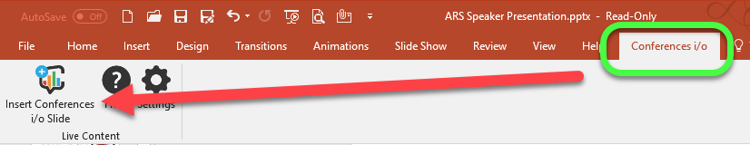
Add polls to PowerPoint (Method #2 cont’d)
6. Go to the Conferences i/o menu
7. Select Insert Conferences i/o Slide.
Notes:
Once you decide it’s location, go to the insert tab and select “ Add Conference i/o Slide”

Slide 28
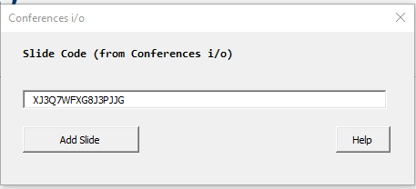
Add polls to PowerPoint (Method #2 cont’d)
Paste Slide Code.
9. Click Add Slide.
10. Repeat until all polls are entered in desired location(s).

Slide 29
Now Let’s see the End Result!
Note: to test, you must have the PowerPoint add-in installed as mentioned previously

Slide 30
1. Open your browser on your cell phone or tablet
2. Go to ______.cnf.io
3. Click on your session
4. Start your PowerPoint slide show and test your polls

